Slide 1












Spring Term
Hummingbirds
Mrs Connery
Year 1/2

Slide 2

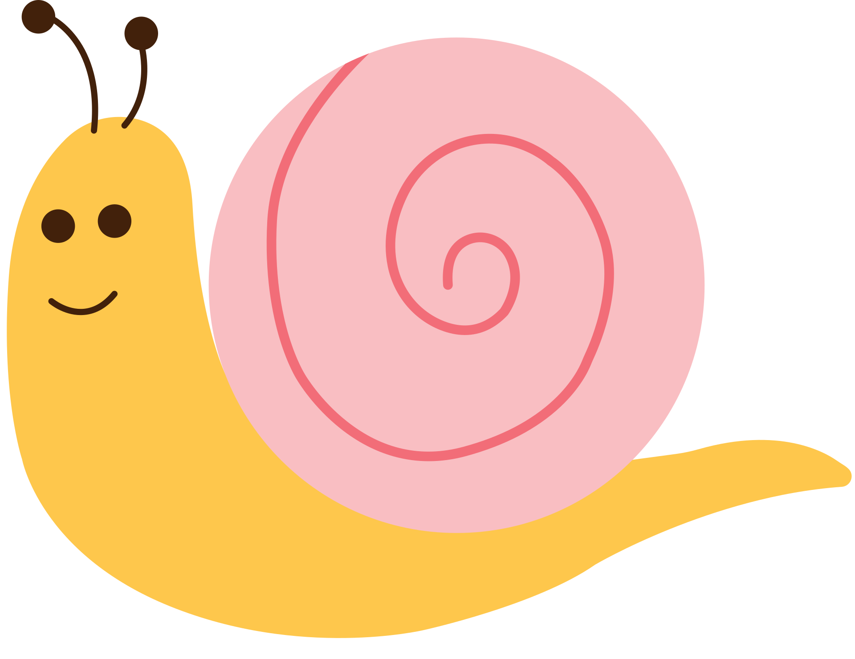


Hummingbirds Class Blog
We have been very busy this term and we would like to share with you some of the fun things we have been up to.

Slide 3

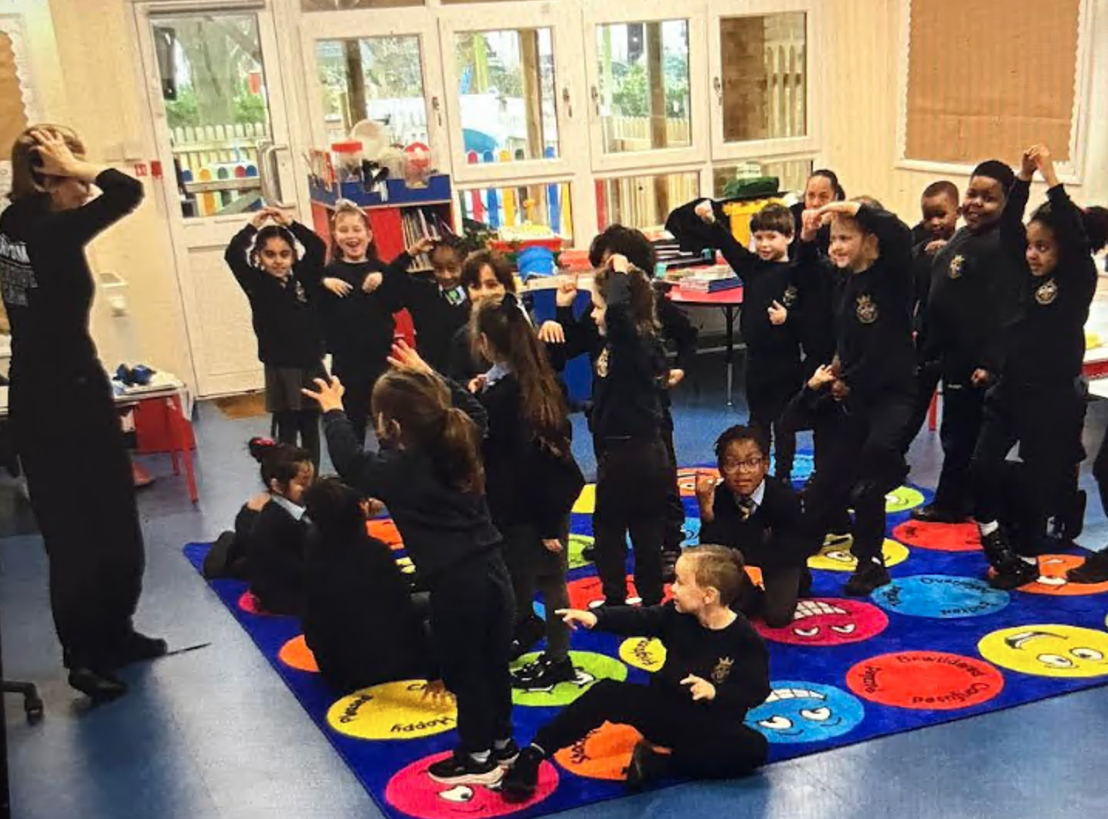
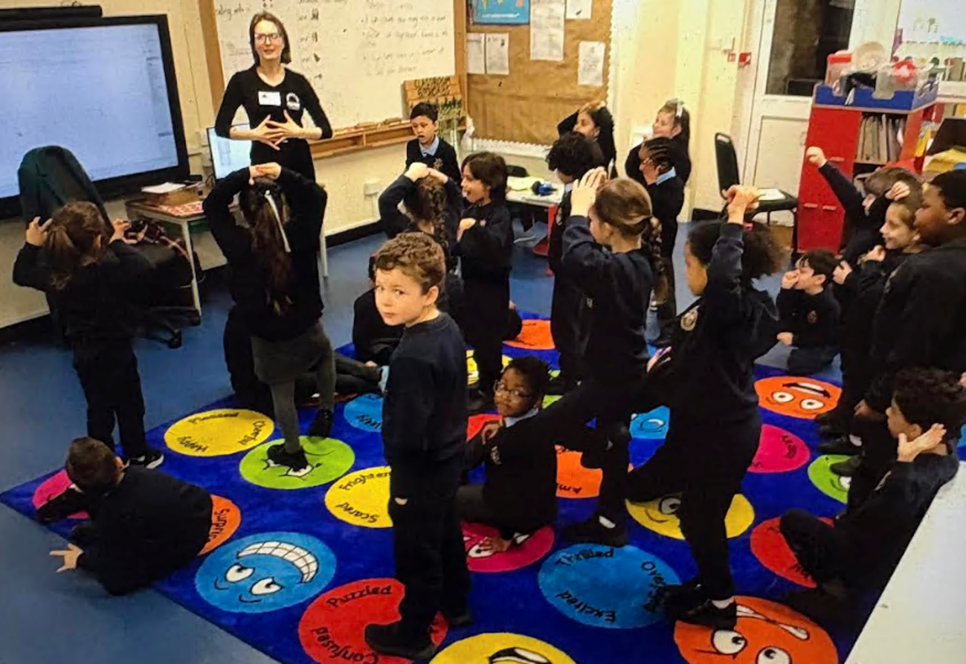


Drama Workshop
The children really enjoyed their Drama Workshop.
They went on an adventure through a magical toy store searching for the special Golden Key.
There was listening, team games and lots of fun had.

Slide 4



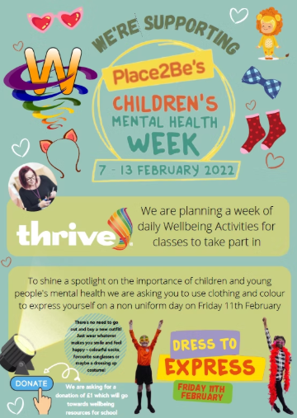

Children’s Mental Heath Week
9th FEB-15th FEB
Children’s Mental Health Week 2026 is an annual initiative organised by the children’s mental health charity Place2Be to raise awareness of young people’s mental health and encourage open conversations about emotional wellbeing in schools across the UK. The official theme, “This Is My Place,” highlights the importance of belonging, helping children feel valued, connected, and supported within their school communities. A strong sense of belonging is linked to improved confidence, relationships, engagement, and academic outcomes.
The children enjoyed special assemblies and lessons dedicated to exploring their mental health and how important it is.
We recapped over ‘Zones of Regulations’ and talked through what to do it we ever feel worried or concerned.

Slide 5
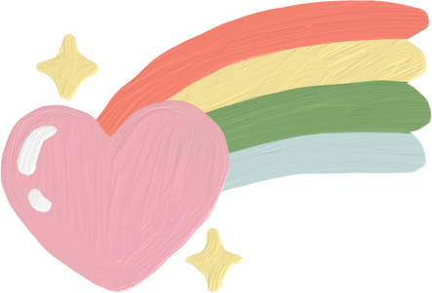





Children's Mental Health Week
Ruby’s worry
Ruby is a happy, confident little girl who enjoys doing all the things children love—playing, exploring, and spending time with friends. One day she notices a small worry following her around. At first it’s tiny, but the more Ruby thinks about it and keeps it to herself, the bigger it grows. Soon the worry begins to get in the way of the things she enjoys.
Eventually, Ruby notices another child with a worry too. When they start talking, something important happens: their worries shrink. Ruby learns that sharing how we feel can help lighten the weight of our worries.
What the children could take from this wonderful story
Everyone has worries sometimes.
Worries can grow if we keep them inside.
Talking to someone we trust can help us feel better.
Dress to Express
The children had the a lovely day for Day to Express. It was like a beautiful rainbow in the Kingfishers classroom and everyone was in great spirits.

Slide 6
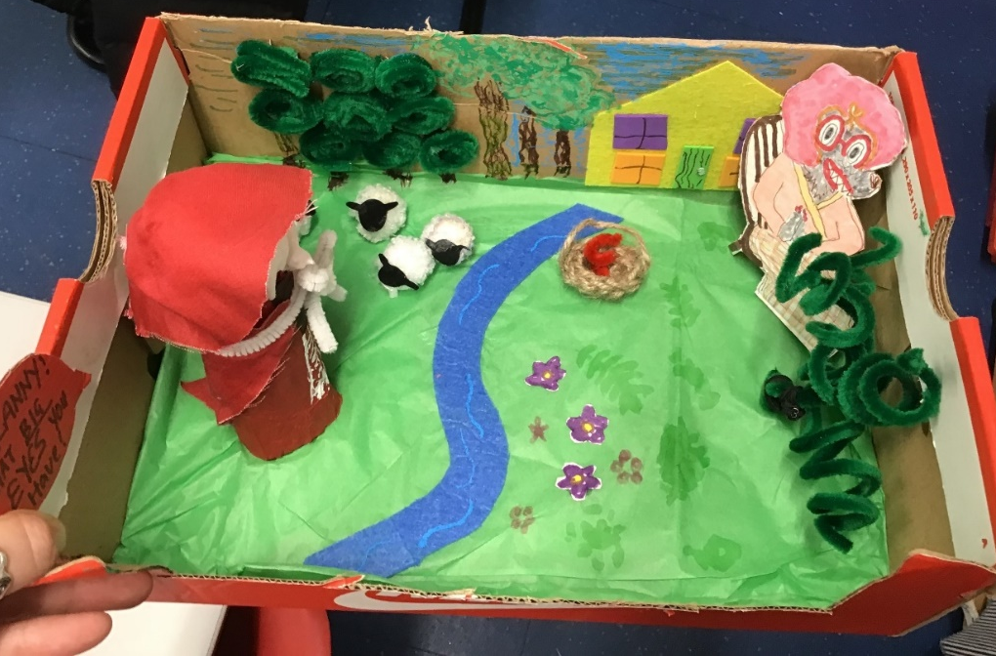
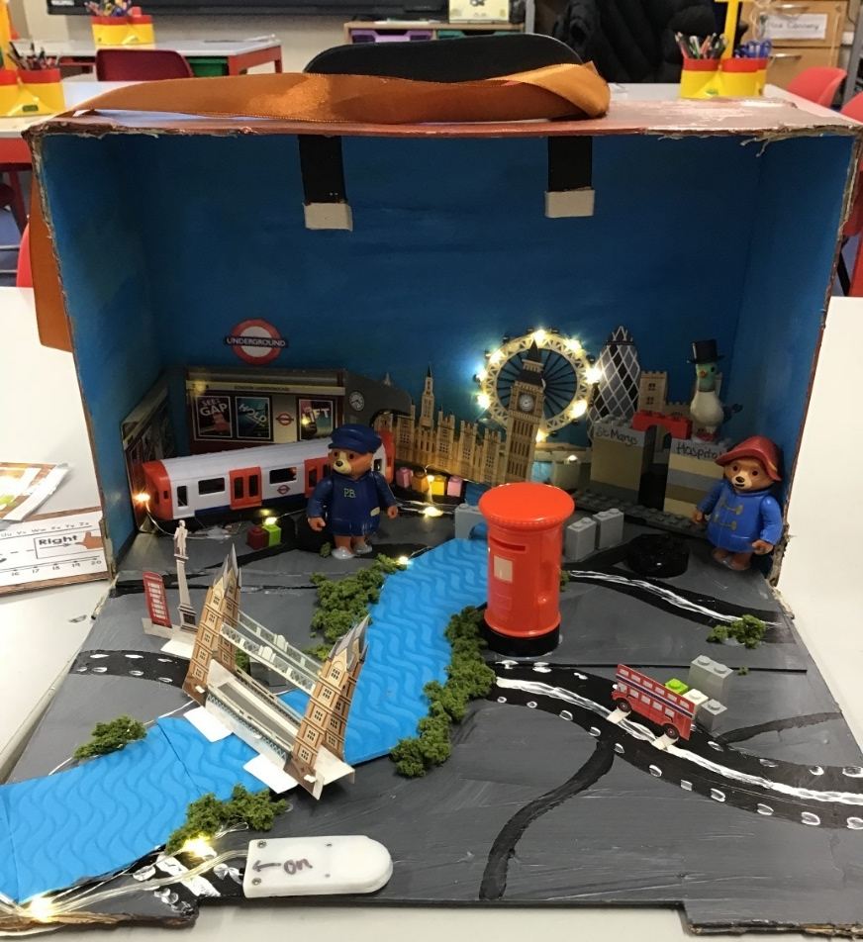
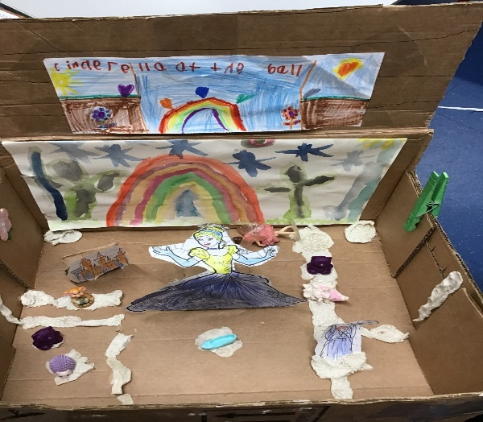
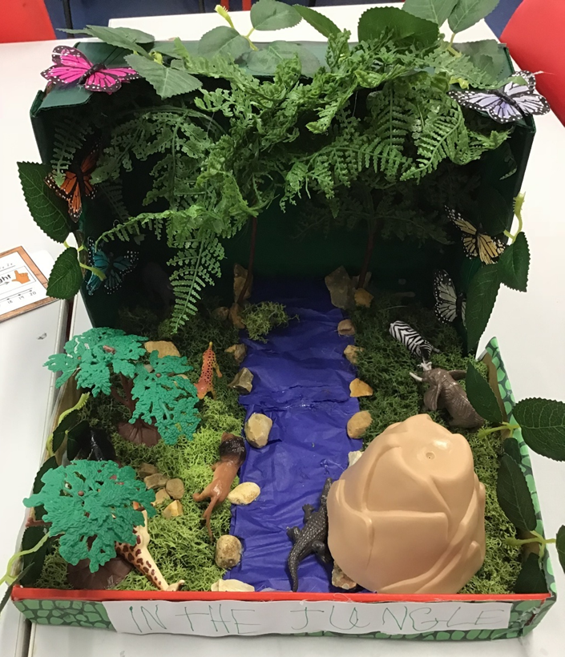
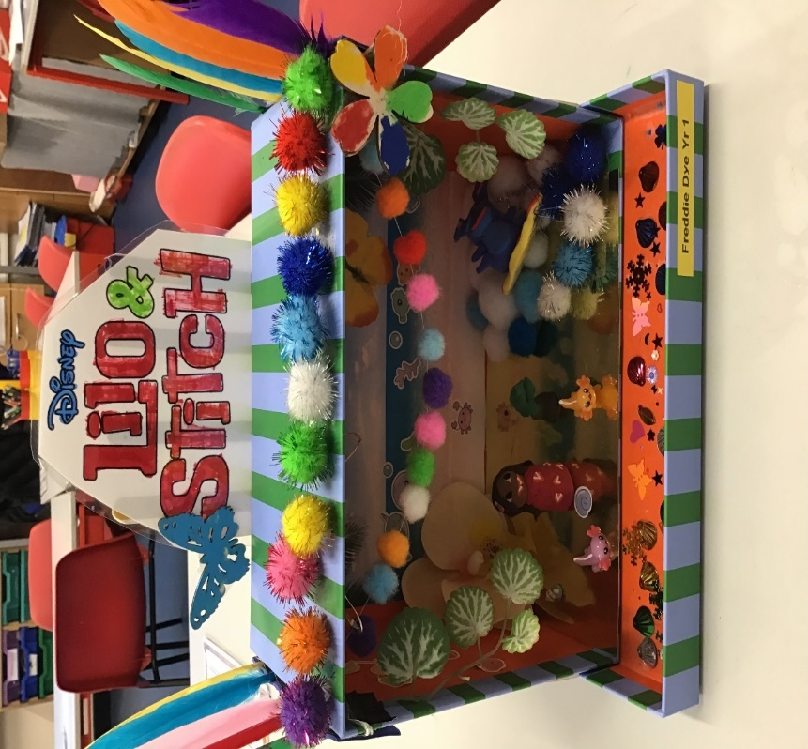
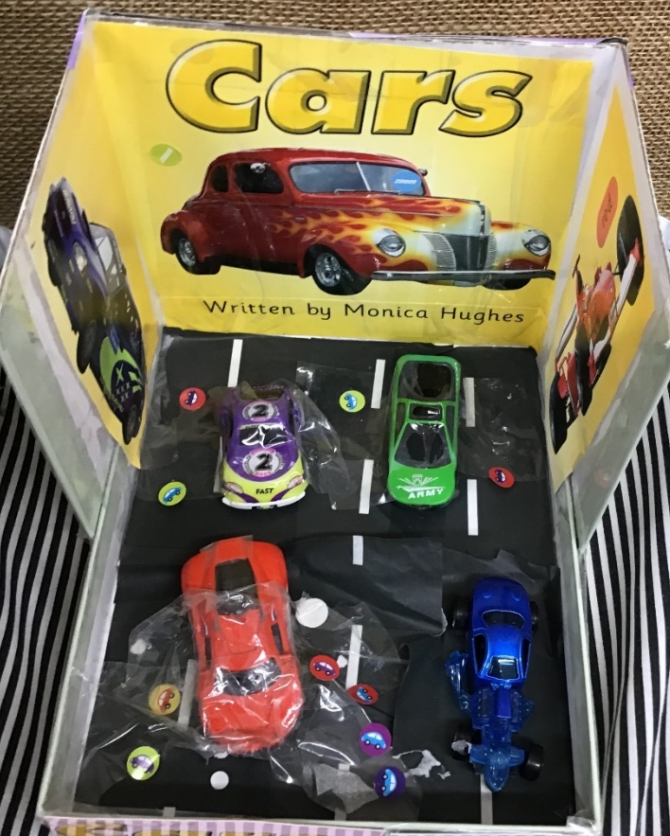
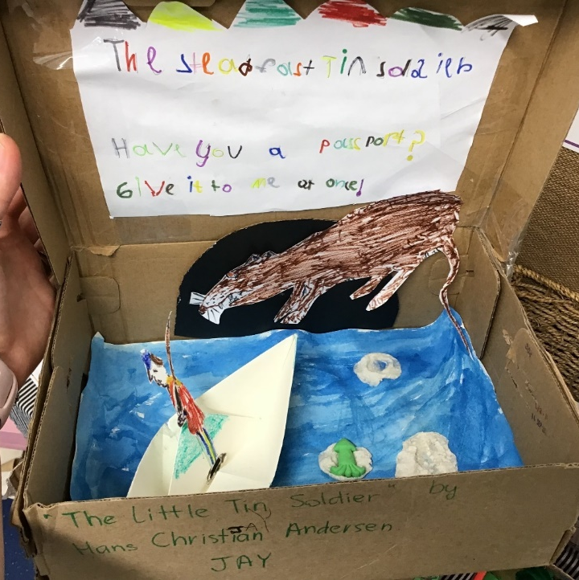
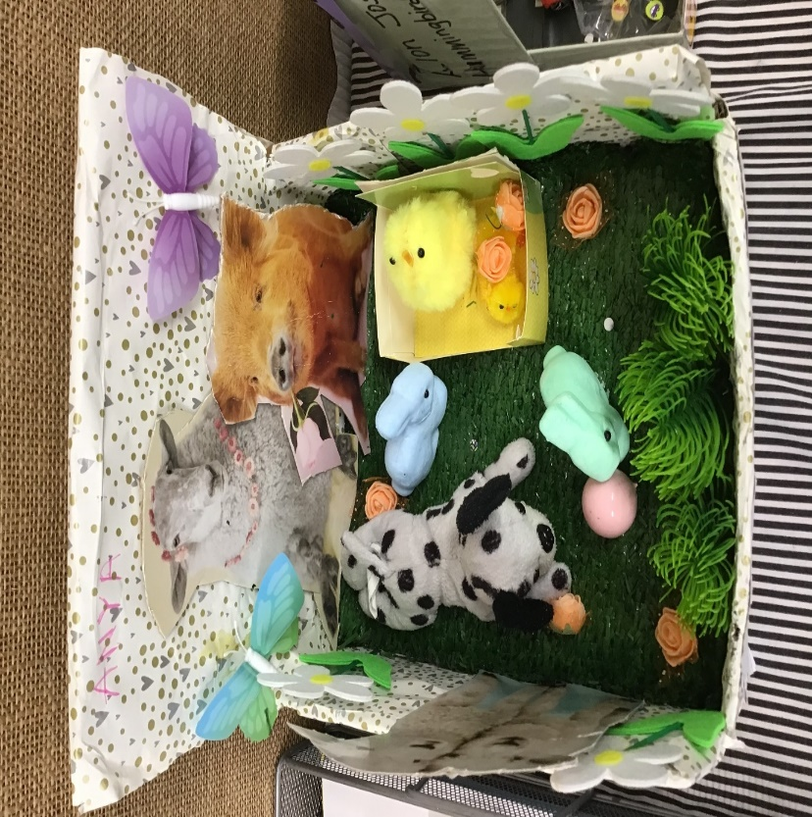
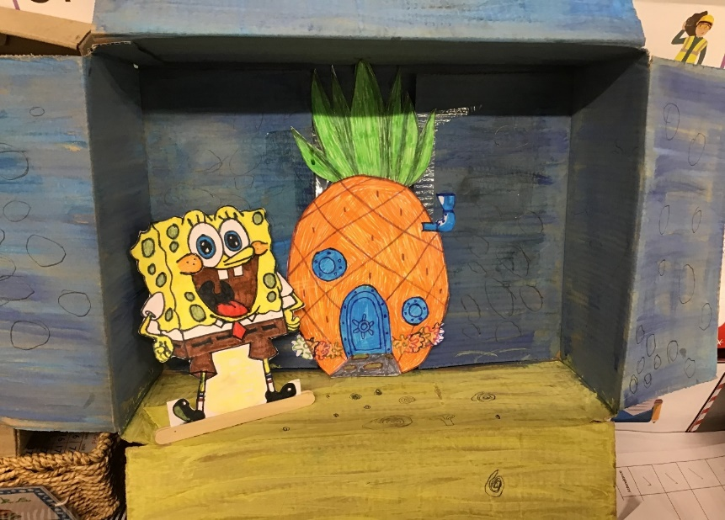

Book in a box
I was blown away with the ‘Book in the Box’ entries this year. You could tell how much effort and time had been put into each and everyone and the children really enjoyed sharing their amazing creations with the class during a ‘show and tell’ session. The children were so complimentary and supportive of each other. Miss Brown had her work cut out for her during judging.

Slide 7

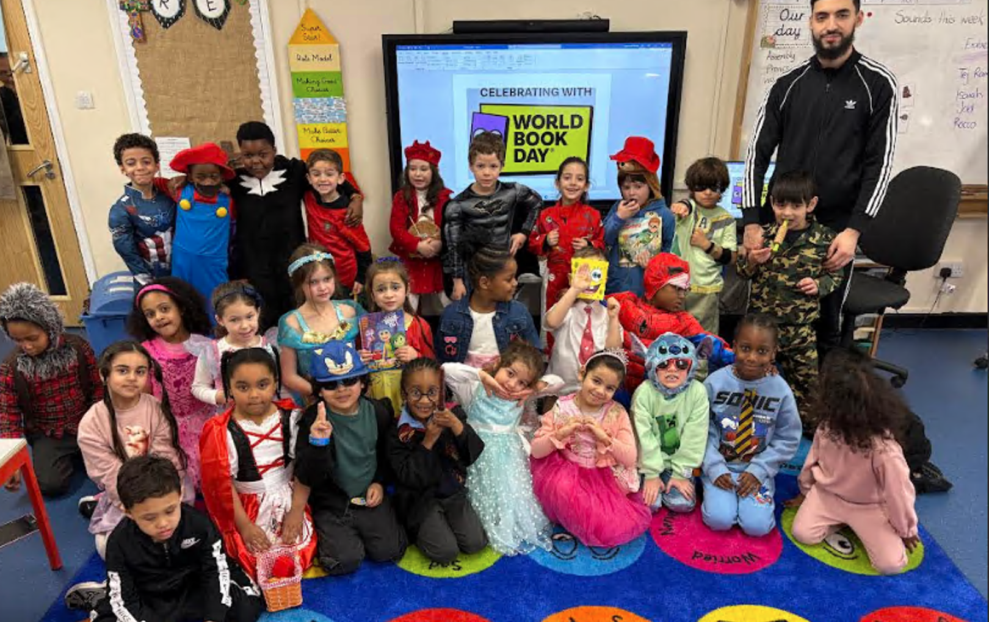

World Book Day
Buddie Reading
The children of Hummingbirds were delighted to be joined by the children from YR5 Herons. They spent some quality time in the glorious sunshine sharing the books they brought in. They took in turns reading to each other and it was a joy as a teacher to see so much excitement and love around reading.

Slide 8

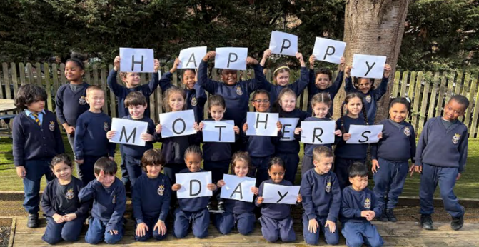
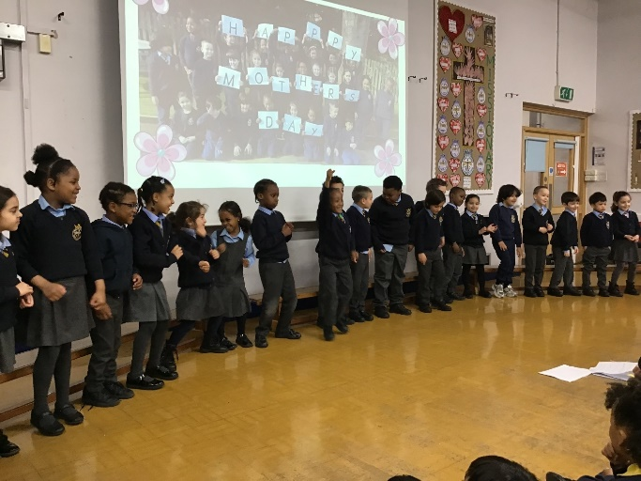
Mothers Day Class Assembly
We were delighted to celebrate Mother’s Day with our recent class assembly. The children worked incredibly hard to share songs, poems, and thoughtful messages to show their appreciation for all the special people who care for them. It was a lovely opportunity for the class to express gratitude and reflect on the importance of kindness, love, and family. We are very proud of how confidently the children performed and the effort they put into making the assembly so meaningful.

Slide 9

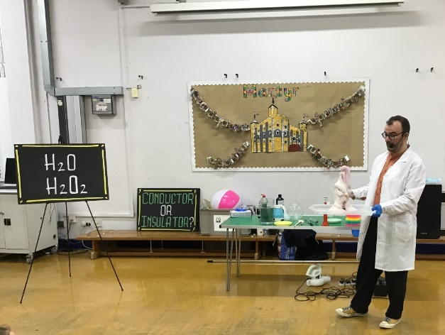
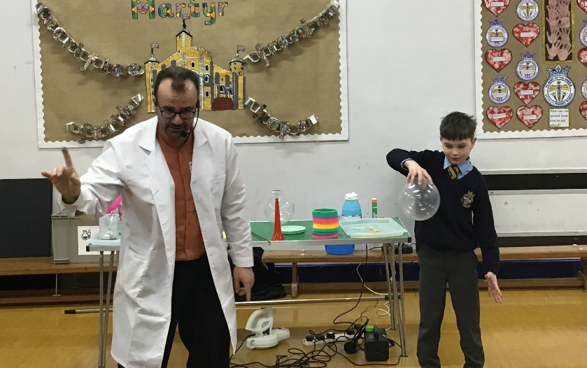
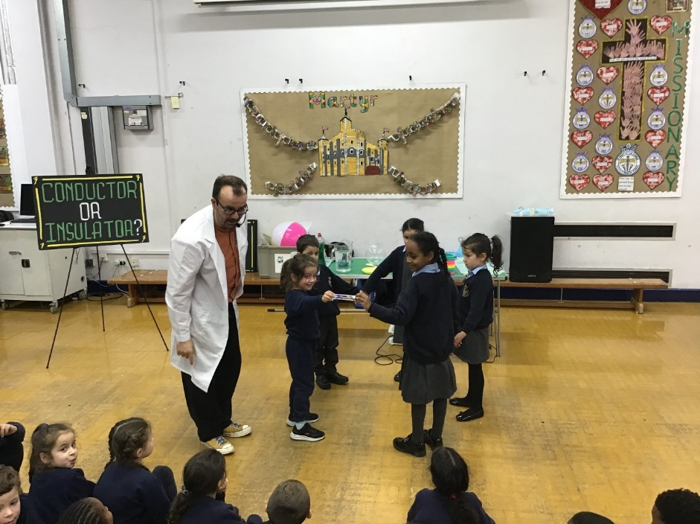
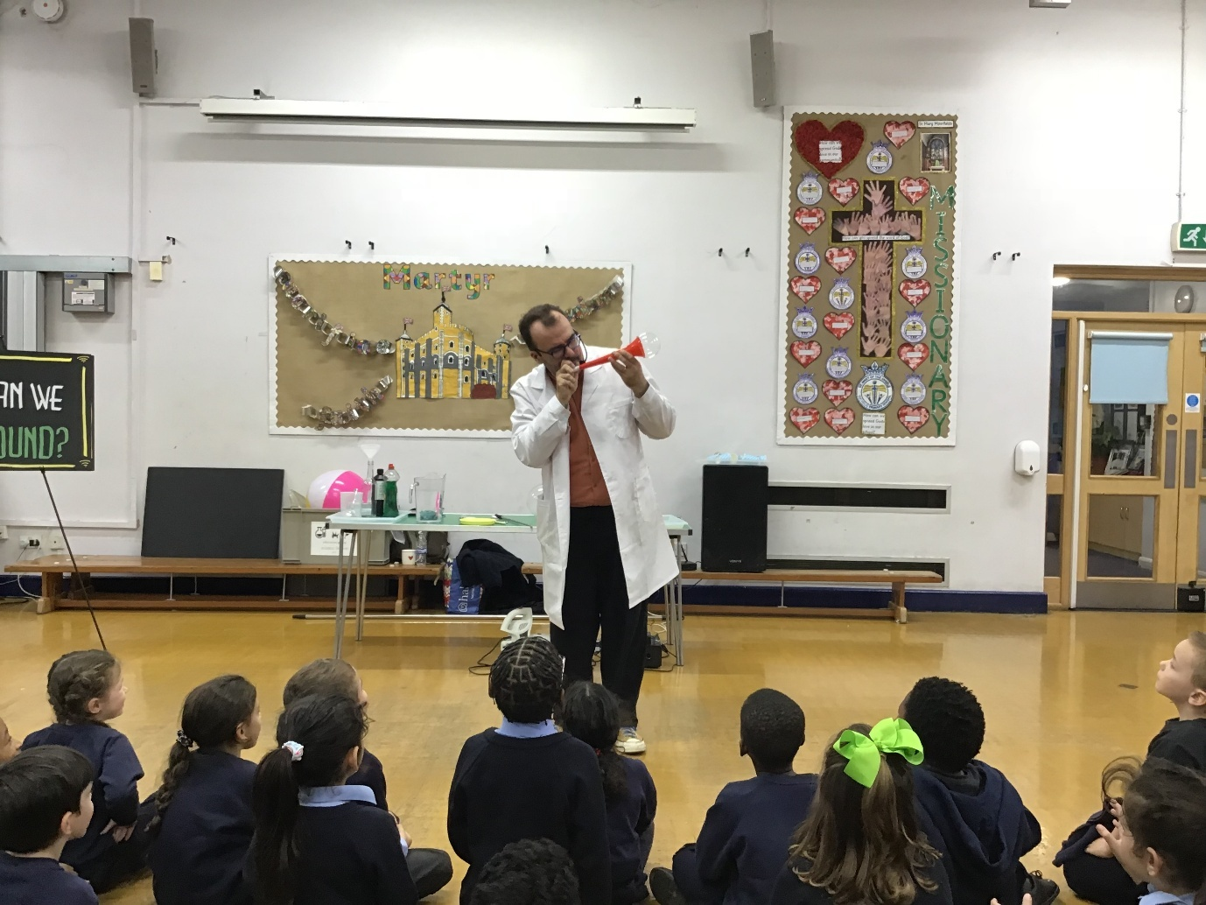
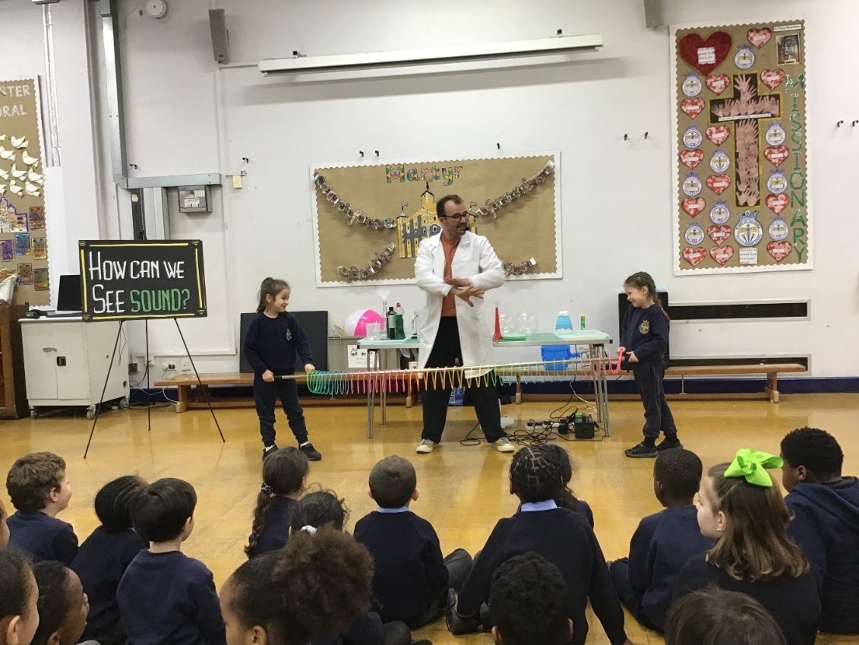
Science Workshop
What a fun morning KS1 had with Professor Nitrate, we learned so much in our science workshop and got to take part and watch so many interesting experiments. We explored insulators and conductors and we were amazed to find out that humans are conductors and when we create a circuit by holding hands the energy moves through us. We also learnt how sound travels and so much more that we are sure you have heard all about. It has been lovely to see how enthusiastic the children have been about science and we can’t wait to complete more experiments.

Slide 10
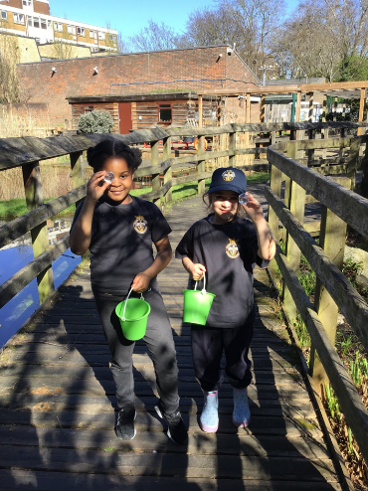

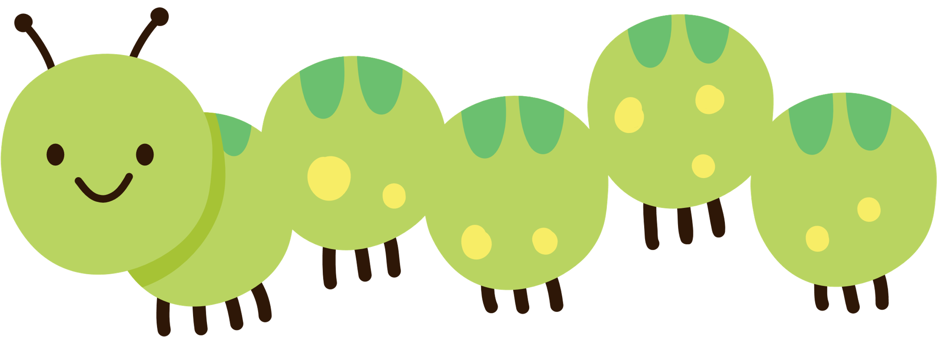
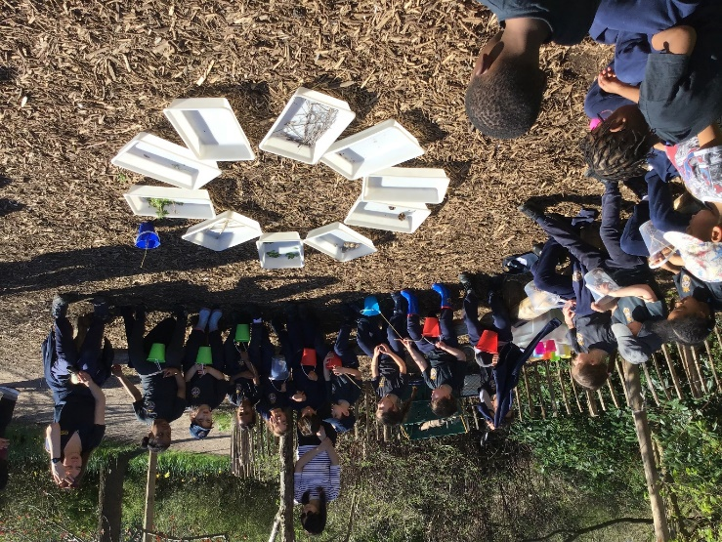
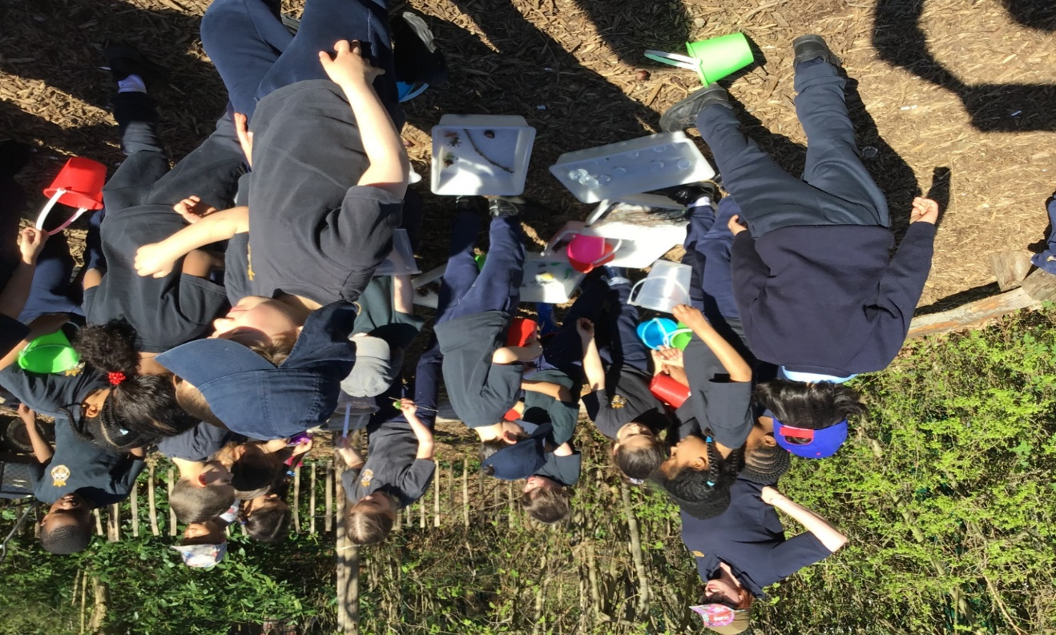
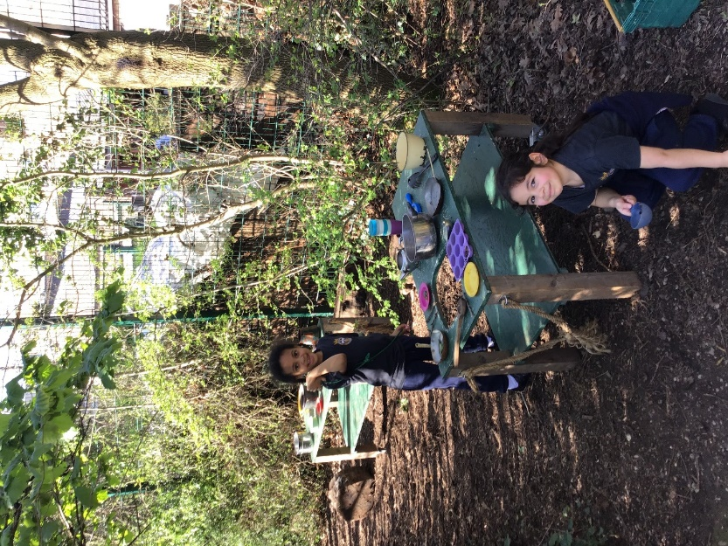
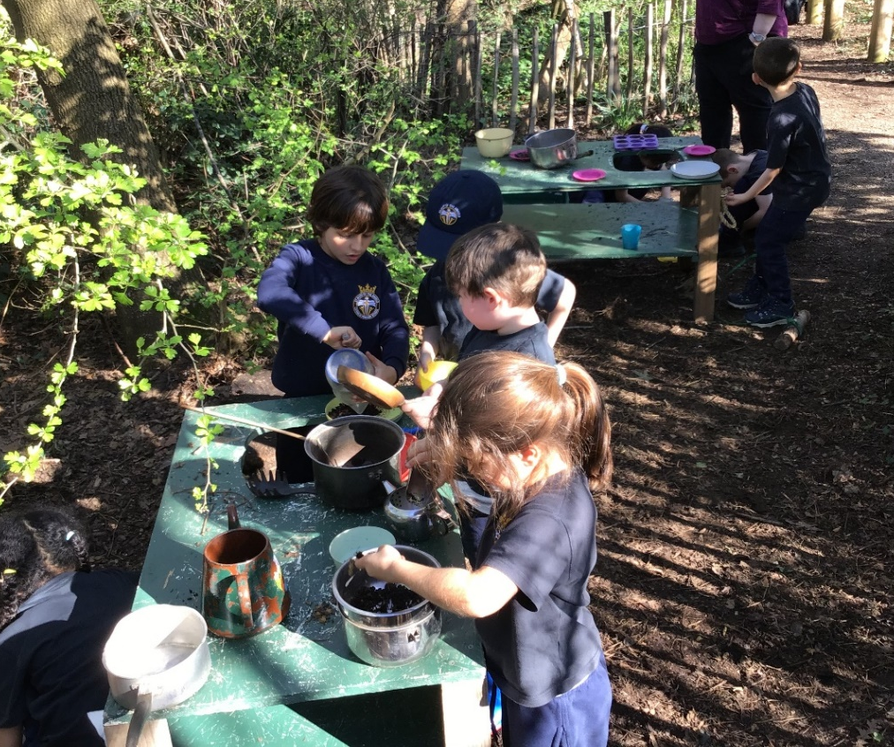
Forest School
The Hummingbirds had a lovely afternoon in the sunshine at forest school. We loved exploring the enclosed area and finding the different treasures that were hidden. The sparkling crystals were definitely our favourite! We also loved playing in the mud kitchen and running around with our pet ‘log-dogs’. A big thank you to the lovely mummy’s that joined us we appreciate your help!

Slide 11
Such a happy, busy term!

